Slide 1

General Introduction
SWORD, File Types
2021 Jan| TSC Nanjing

Slide 2
General Introduction
Agenda
0 1
DB Schenker, TSC, EDI, SWORD Introduction
02
SWORD Framework
0 3
File Types

Slide 3
General Introduction
Objectives
Understand what is EDI
Understand what SWORD do, workflow, related partners
Understand SWORD Environment, Stream, Node, Server
Know all the data types SWORD handles
Master EDIFACT, X12 Message structure
Be able to see Message Type, Message Version, Segment Delimiter, Element Delimiter, Composite Delimiter from given message.

Slide 4
General Introduction
Agenda
0 1
DB Schenker, TSC, EDI, SWORD Introduction
02
SWORD Framework
0 3
File Types

Slide 5
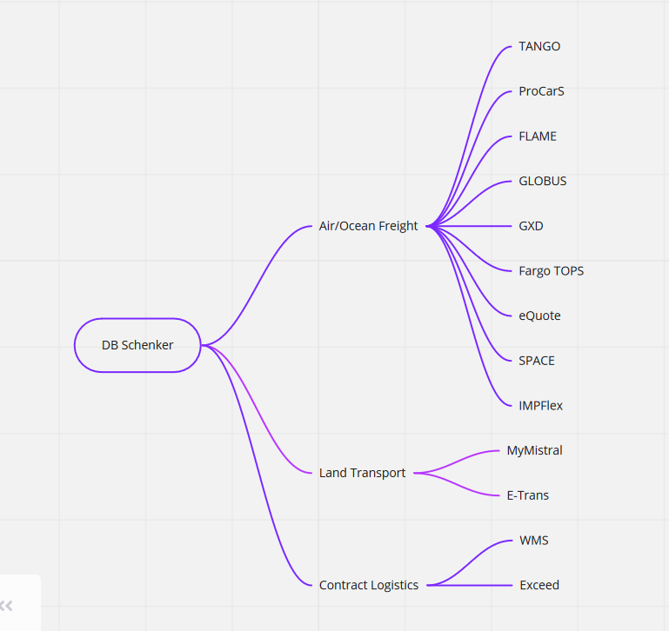
DB Schenker

Slide 6
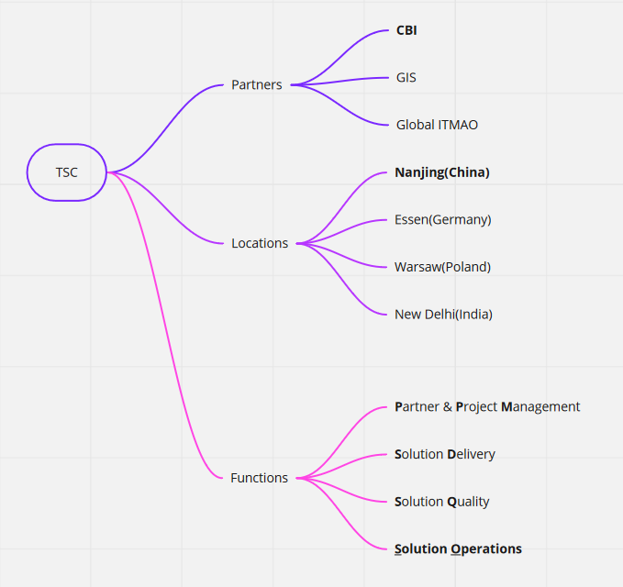
TSC

Slide 7
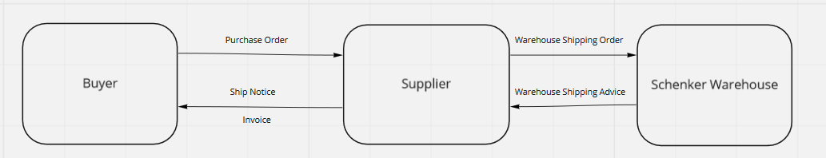
EDI

Slide 8
EDI
Electronic Data Interchange
computer-to-computer exchange
business documents
standard electronic format
business partners

Slide 9
EDI
Benefits
reduce cost
increase processing speed
reduce errors
improve relationships with business partners

Slide 10
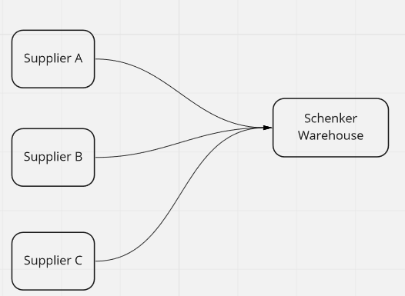
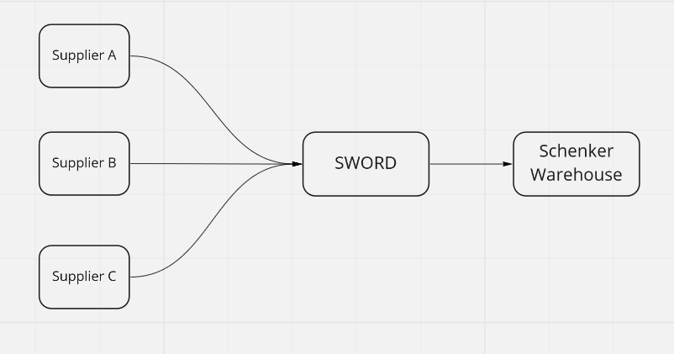
SWORD
Schenker Worldwide Real-time Data network
https://b2bidevweb1.sl3-test.comp.db.de:8443/

Slide 11
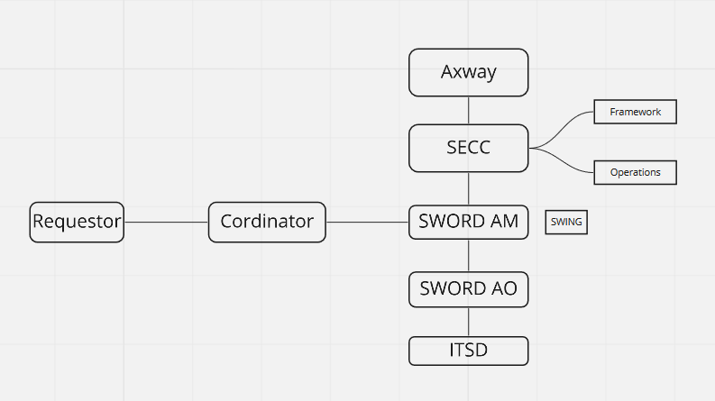
SWORD
Region:
Corporate
APAC
Europe
America

Slide 12
General Introduction
Agenda
0 1
DB Schenker, TSC, EDI, SWORD Introduction
02
SWORD Framework
0 3
File Types

Slide 13
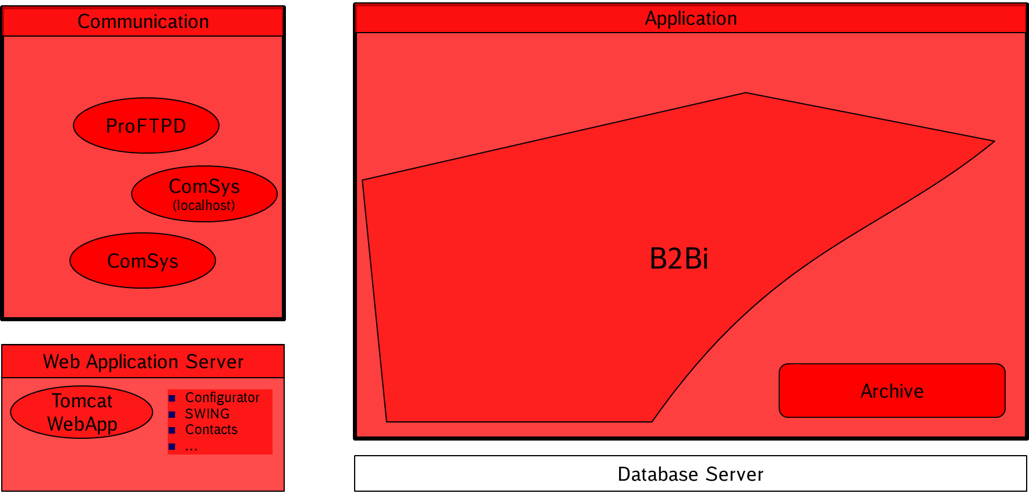
SWORD Framework

Slide 14

SWORD Framework
SWORD Configurator GUI
Development by SWORD / SECC¹⁾
Local Development / SECC¹⁾
Locally developed MBCs²⁾ (including mappings)
Framework Toolbox MBCs²⁾
ComSys
SWING Monitoring
B2Bi
Axway
Oracle RDBMS 12c
Websphere MQ
Oracle
IBM
Red Hat Enterprise Linux (Amazon Web Services)

Slide 15
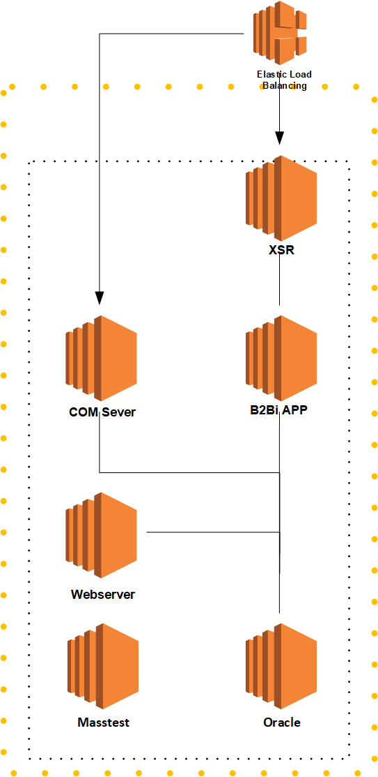
SWORD DEV

Slide 16
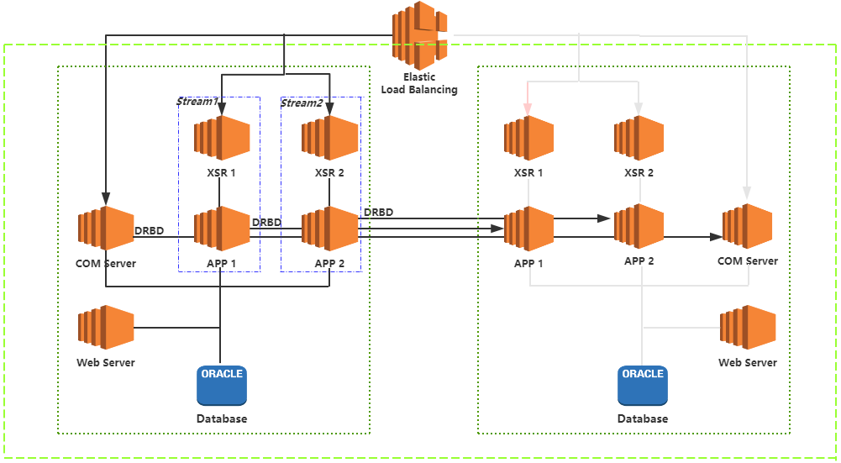
SWORD TEST

Slide 17
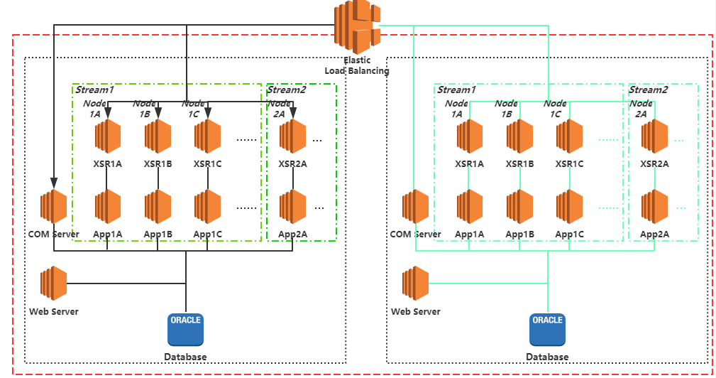
SWROD PROD

Slide 18
B2Bi Streams
Environment | Stream | Node
DEV | 1 | 1A
TEST | 1 | 1A
 | 2 | 2A
PROD | 1 | 1A
 |  | 1B
 |  | 1C
 |  | 1D
 |  | 1E
 |  | 1F
 | 2 | 2A
SystemOverviewB2BiStreams

Slide 19
General Introduction
Agenda
0 1
DB Schenker, TSC, EDI, SWORD Introduction
02
SWORD Framework
0 3
File Types

Slide 20
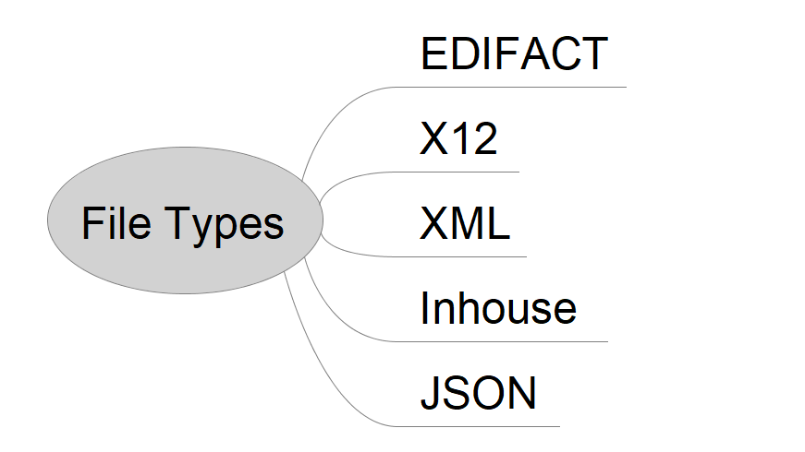
File Types

Slide 21
ANSI X12
the American National Standards Institute (ANSI)
In 1979
in North America
Reference: www.x12.org

Slide 22
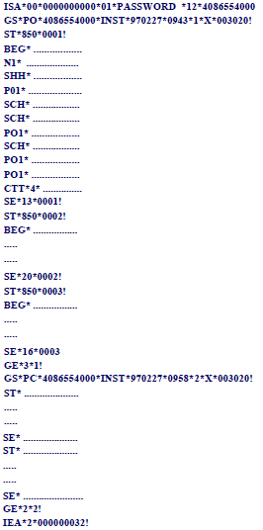
X12 Structure and Enveloping
For each message, there are three levels of envelopes
Segment
Message
Message
Interchange (ISA/IEA)
Message
Functional Group (GS/GE)
Message
Transaction Set (ST/SE)
Message

Slide 23
ISA, IEA Segments
ISA: Interchange header for X12 document, outermost layer of EDI envelope
No | Element Name | Description | No | Element Name | Description
1 | Authorization Information Qualifier | Value: 00 - no authorization info. | 9 | Date | Format: YYMMDD
2 | Authorization Information | Additional info. about the sender | 10 | Time | Format: HHMM(SS), 24-hour clock
3 | Security Information Qualifier | Value: 00 – no security info. | 11 | Control Standards Identifier | Identifies the agency responsible for the control standard the message uses
4 | Security Information | Security info. about the sender | 12 | Control Version Number | Only applies to the interchange control segment
5 | Interchange ID Qualifier (sender) | Defines the code used in the interchange sender | 13 | Interchange Control Number | Uniquely identifies the interchange
6 | Interchange Sender ID | A unique code identifying the sender of the interchange | 14 | Acknowledgement Requested | Value: 0 - not requested
7 | Interchange ID Qualifier (receiver) | Defines the code used in the interchange receiver | 15 | Usage Indicator | Value: P - Production; T - Test
8 | Interchange Receiver ID | A unique code identifying the recipient of the interchange | 16 | Component Element Separator | Reserved for future expansion, for separating data element subgroups

Slide 24

ISA, IEA Segments
IEA: Interchange trailer of X12 functional groups, indicating the end of an interchange
No | Element Name | Description | No | Element Name | Description
1 | Number of Included Functional groups | Generated by the sender | 2 | Interchange Control Reference | Same as the Interchange Control Number in the ISA segment

Slide 25

GS, GE Segments
GS: Functional group header of a set of X12 documents of the same document type
No | Element Name | Description | No | Element Name | Description
1 | Functional Group ID | Identifies one type of message in the functional group | 5 | Time of Preparation | The time that the interchange was prepared, 24-hour clock format
2 | Application Senders Code | Same as the Interchange Sender ID in the ISA segment | 6 | Group Control Number | Maintained by the sender, must be unique to each trading partner
3 | Application Receivers Code | Same as the Interchange Receiver ID in the ISA segment | 7 | Responsible Agency Code | Identifies the organization responsible for publication
4 | Date of Preparation | The date that the interchange was prepared, format: YYMMDD | 8 | Version/Release/Industry id code | Version, release, and industry code of the functional group
GE: Functional group trailer, indicating the end of a group of transaction sets
No | Element Name | Description | No | Element Name | Description
1 | Number of Transaction Sets Included | Generated by the sender | 2 | Group Control Number | Same as the Group Control Number in the GS segment

Slide 26


ST, SE Segments
ST: Transaction set header of an X12 documents
No | Element Name | Description | No | Element Name | Description
1 | Transaction Set Identifier Code | e.g. 850, 110, … | 2 | Transaction Set Control Number | Assigned by the sender of the transaction set
SE: Transaction set trailer, indicating the end of a transaction sets
No | Element Name | Description | No | Element Name | Description
1 | Transaction Set Identifier Code | e.g. 850, 110, … | 2 | Transaction Set Control Number | Assigned by the sender of the transaction set

Slide 27
Data Element Type
Numeric (N) - only numeric characters and a minus sign if negative
Decimal (R) - only numeric characters, a decimal point (if needed), and a minus sign if negative
String (AN) - alphanumeric characters, including embedded spaces
Date (DT) - in the format: YYMMDD or CCYYMMDD
Time (TM) - in the format: HHMMSSd..d (24-hour clock)
Binary (B) - a sequence of octets ranging in a value from 00000000 to 11111111
ID - if ANSI ASC X12 maintains the list of ID codes, the code values follow the data element definition in the data element dictionary

Slide 28
ANSI X12 Most Used Messages
Message | Business Documents
850 | Purchase Order
940 | Warehouse Shipping Order
945 | Warehouse Shipping Advice
856 | Ship Notice/Manifest
810 | Invoice
214 | Transportation Carrier Shipment Status

Slide 29
EDIFACT
Electronic Data Interchange For Administration, Commerce and Transport
international standard for EDI
developed by the United Nations
approved as the ISO 9735 standard in 1987
provides rules on how to structure data and standardize messages for multi-industry and multi-country exchange
EDIFACT Directories are released twice every year from the United Nations (UN).
Backward compatible: a new EDIFACT Directory does not make the Directories of previous years invalid
Reference: http://www.edifactory.de/

Slide 30
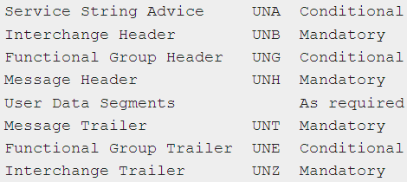
EDIFACT Structure and Enveloping
For each message, there are three levels of envelopes
Interchange
Functional Group
Message
UNB, UNZ: Interchange header and trailer
UNG, UNE: Only used when the interchange carries different groups of messages of different types
UNH, UNT: Message header and trailer
Reference: http://www.edifactory.de/download/ISO9735.TXT

Slide 31
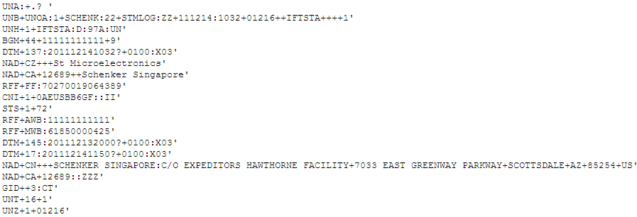
EDIFACT Example File
Interchange
Message

Slide 32

UNA Segment
UNA: Conditional Service String Advice, specifying the separator and other service characters used in the interchange
Character | Character Name | Description
‘ | Apostrophe | Segment terminator
+ | Plus sign | Segment tag and data element separator
: | Colon | Component data element separator
? | Question mark | Release character. Immediately preceding any of the special characters ‘+:?, the release character returns it to its normal meaning. For example, 10?+10 =20 means 10+10 = 20. Question mark is represented by ?? A release character is not counted when calculating the maximum length of the data element.
. | Period | Decimal point, not requiring a release character when it occurs as a normal text punctuation mark.

Slide 33

UNB, UNZ Segments
UNB: Interchange header, to start, identify and specify an interchange
Ref. | Element Name | Ref. | Sub-Element Name | Description
S001 | Syntax identifier | 0001 | Syntax identifier | A sender’s unique message reference
 |  | 0002 | Syntax version number | Controlling agency and stating level, e.g. UNOA
S002 | Interchange sender | 0004 | Sender identification | Code or name as specified in IA
S003 | Interchange recipient | 0010 | Recipient identification | Code or name as specified in IA
S004 | Date/time of preparation | 0017 | Date | YYMMDD
 |  | 0019 | Time | HHMM
0020 | Interchange control reference |  |  | Unique reference assigned by sender
..... | Other elements | http://www.edifactory.de/download/ISO9735.TXT
UNZ: Interchange trailer, to end and check the completeness of an interchange
Ref. | Element Name | Description | Ref. | Element Name | Description
0036 | Interchange control count | The count of the number of messages or functional groups in the interchange | 0020 | Interchange control reference | Identical to 0020 in UNB

Slide 34


UNH, UNT Segments
UNH: Message header, to head, identify and specify a message
Ref. | Element Name | Ref. | Sub-Element Name | Description
0062 | Message reference number |  |  | A sender’s unique message reference
S009 | Message identifier | 0065 | Message type | Type of message being transmitted
 |  | 0052 | Message version number | Identical to 0052 in UNG
 |  | 0054 | Message Release number | Release number within current version number
 |  | 0051 | Controlling agency | Code to identify the agency controlling publication
..... | Other elements | http://www.edifactory.de/download/ISO9735.TXT

Slide 35
EDIFACT Most Used Messages
Message | Business Documents
DESADV | Dispatch advice message
IFCSUM | Forwarding and consolidation summary message
IFTMIN | Instruction message
IFTSTA | International multimodal status report message
INVOIC | Invoice message
INVRPT | Inventory report message
ORDERS | Purchase order message
RECADV | Receiving advice message

Slide 36
EDIFACT Generic Segments
BGM for the beginning of a message, which contains the document number
DTM for dates and times
NAD for name and address data
MOA for monetary amounts

Slide 37
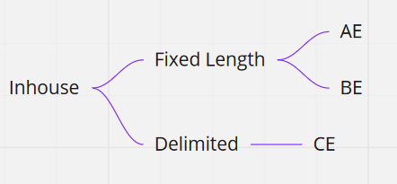
Inhouse

Slide 38
AE, BE
Booking Air
AE record layout – flat file with fixed field position
AE example file
Booking Sea
BE record layout – flat file with fixed field position
BE example file

Slide 39
CE
CIS: Customer Information System, for tracking and tracing
Two types of CE files
Voucher/Invoice
Status messages for tracking and tracing
CE record layout – flat file with fields separated by delimiter
CE example file

Slide 40
XML
<?xml version="1.0" encoding="UTF-8" ?>
<OrderMessage>
<Order>
<Header>
<OrderMessageID>3</OrderMessageID>
<OrderNumber>C299364</OrderNumber>
<OrderDateTime>2012-03-07T12:00:00.000</OrderDateTime>
<PartyInfo>
<Type>ShipTo</Type>
<Code />
<City>
<CityName>SE-501 17 Bor</CityName>
<CityCode Qualifier="UN">XXX</CityCode>
</City>
</PartyInfo>
</Header>
</Order>
</OrderMessage>
XML Declaration
Start tag
Element
Empty-element tag
Attribute
End tag

Slide 41
XML Schema
DTD: Document Type Definition | XSD: XML Schema Definition
The oldest schema language for XML, inherited from SGML Use a terse formal syntax that declares precisely which elements and references may appear where in the document of the particular type Limitations: No explicit support for newer features of XML; Lack expressiveness and readability; Use a syntax based on regular expression syntax | The successor of DTDs – a newer schema language described by the W3C Far more powerful than DTDs in describing XML language Use a rich data typing system and allow for more detailed constraints on an XML document's logical structure Use an XML-based format, which makes it possible to use ordinary XML tools to help process them
SGI

Slide 42
JSON
JSON (JavaScript Object Notation) is a lightweight data-interchange format.
Structure:
Object {“name”:””}
Array []

Slide 43
Thank you

